Slide 1
CCLE Integrative Project
6/22/20

Slide 2
Data Summary
34 breast cancer cell lines
Positive or negative for ER-alpha/ESR1
Originally 47 cell lines, but after PCA to look at batch effect, some were filtered to make downstream analysis easier
RNA-seq
Normalization: TPM
RPPA
Normalization: log2 median-centered
Notes:
ER-alpha based on RPPA data

Slide 3
Steps
Get common genes between RNA-seq and RPPA datasets
Calculate FC for these common genes for RNA and RPPA (total protein values) datasets
Log2(FC) = log2(positive / negative)
Linear regression transformation
RNA = m*RPPA + b

Slide 4
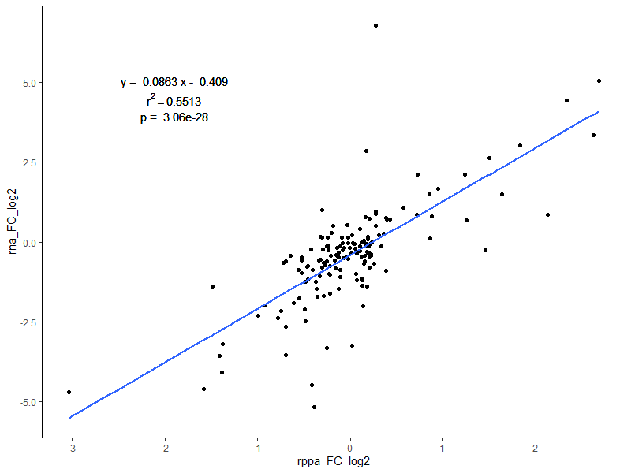
Transformation: Untransformed (w/out phosphorylation)

Slide 5
Pathway Analysis: Untransformed Data

Slide 6
Steps:
Run DESeq2 to find DE RNA genes
log2(abs(FC)) >= 2 & adjusted.pval < .05
Run limma to find DE RPPA genes
Included phosphorylated values
Adjusted.pval < .05
Took union of DE RNA and RPPA genes
Ran pathway analysis on gene lists (upregulated and downregulated) on DAVID and MetaCore
Ran pathway analysis on gene lists with FC on MetaCore
See how FC changes results

Slide 7
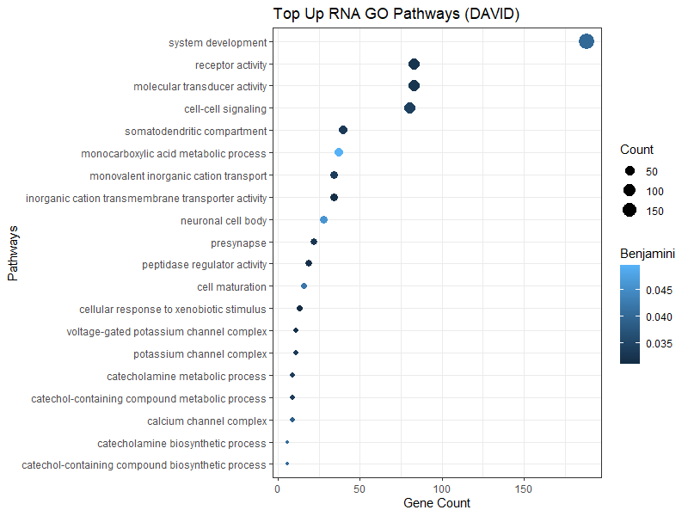
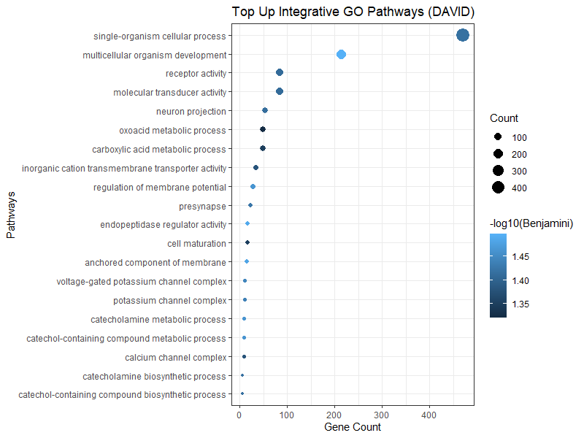
DAVID: Top Upregulated GO

Slide 8
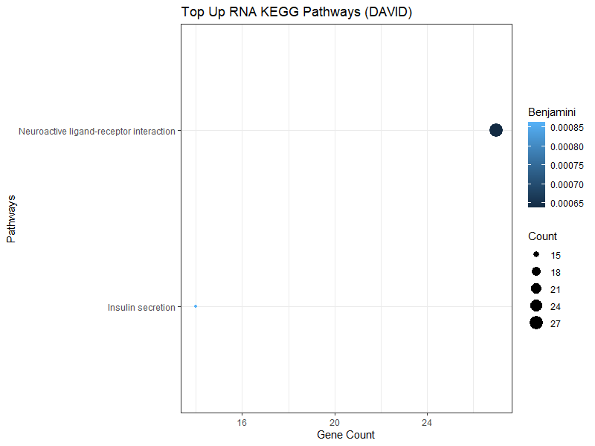
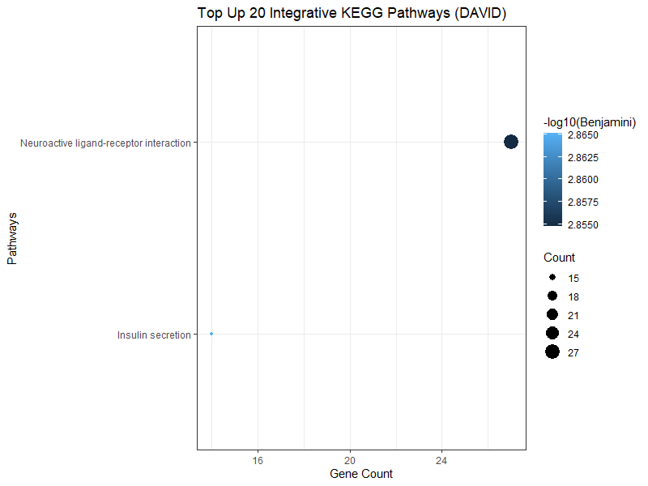
DAVID: Top Upregulated KEGG

Slide 9
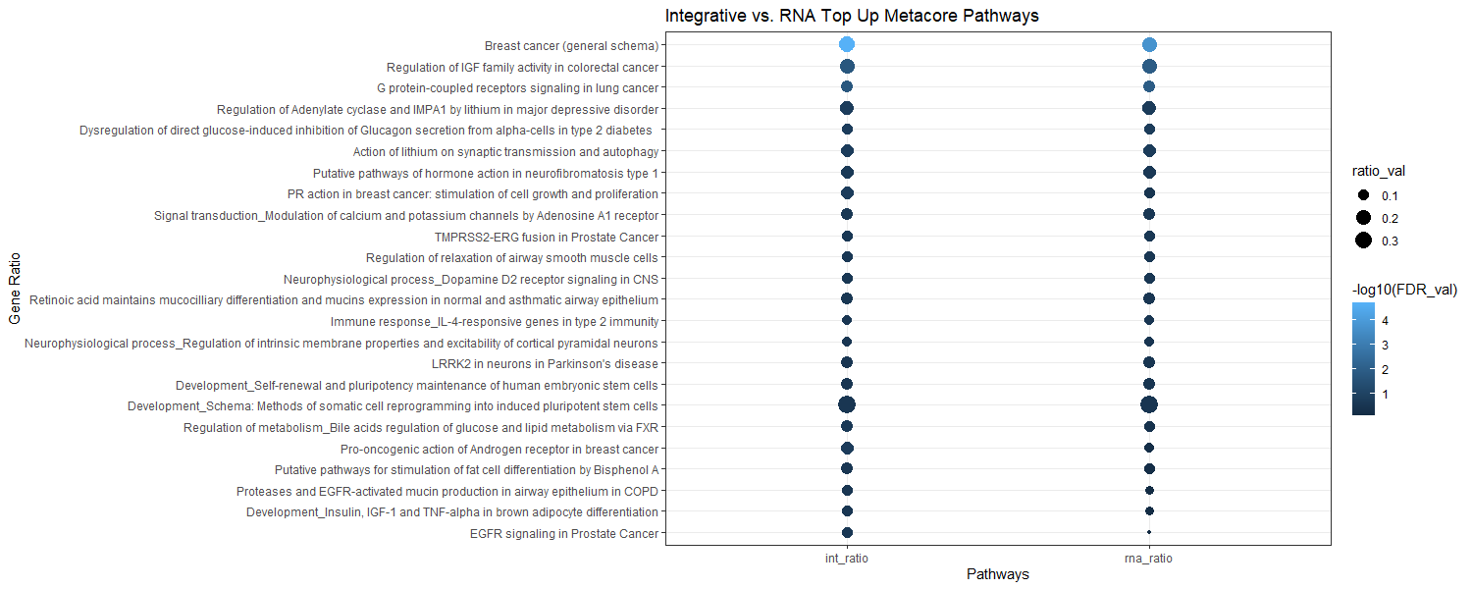
MetaCore: Top Upregulated Pathways

Slide 10
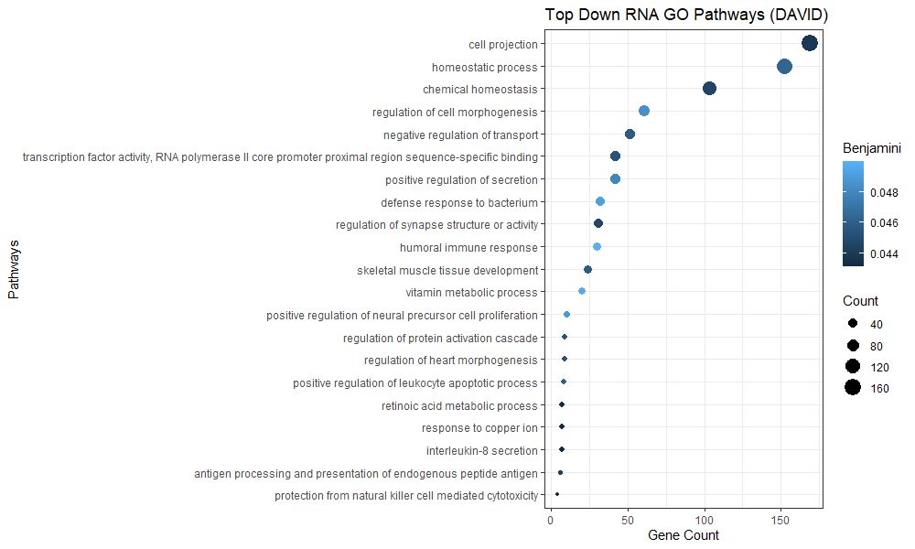
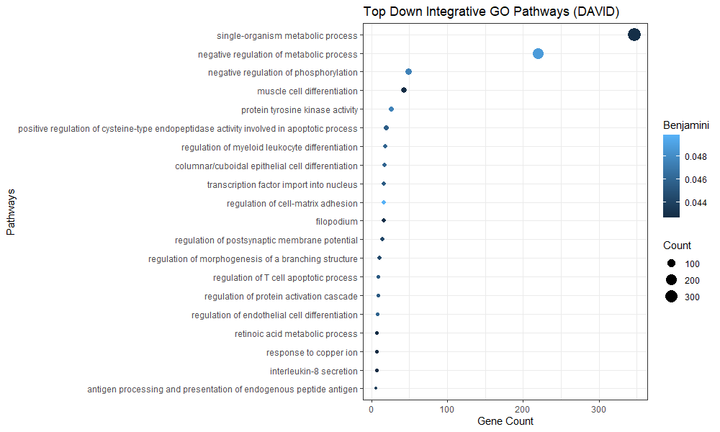
DAVID: Top Downregulated GO

Slide 11
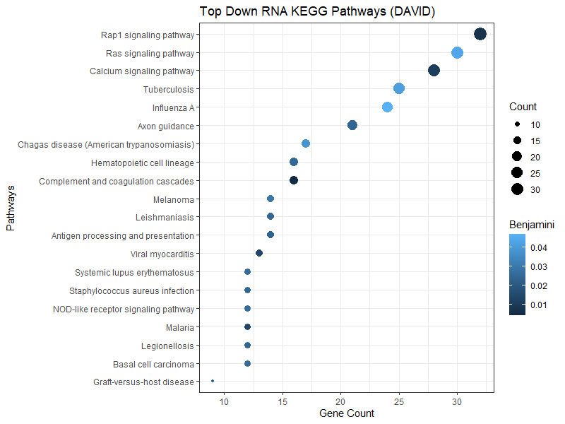
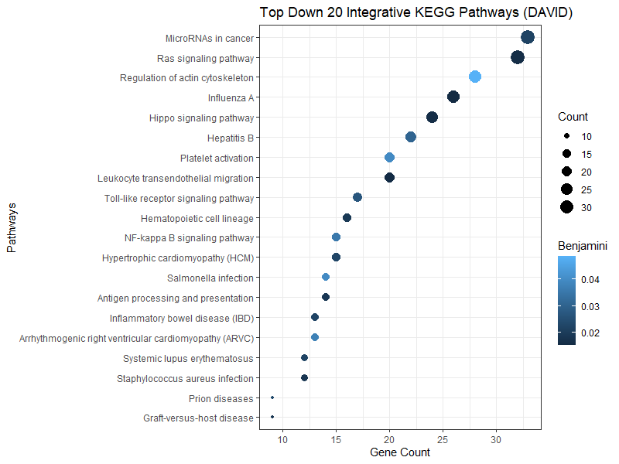
DAVID: Top Downregulated KEGG

Slide 12
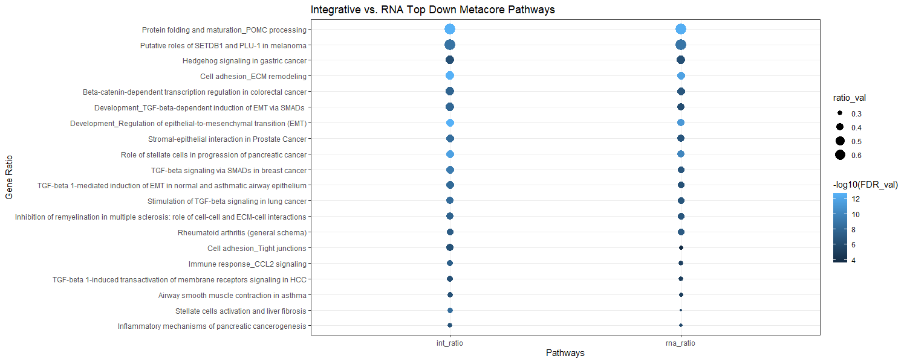
MetaCore: Top Downregulated Pathways

Slide 13
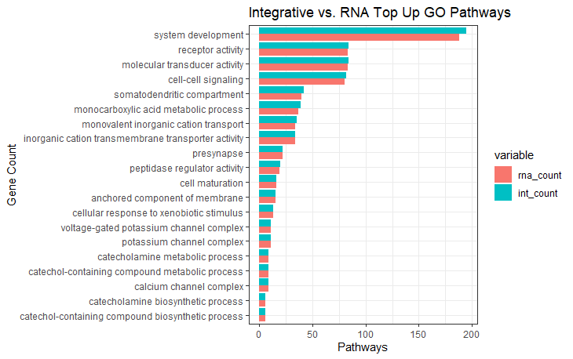
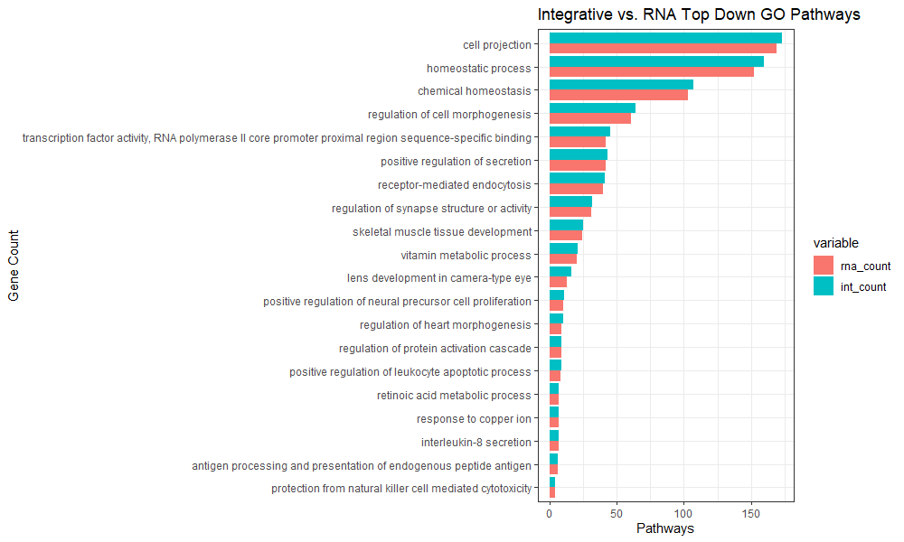
DAVID: Common Paths (GO)

Slide 14
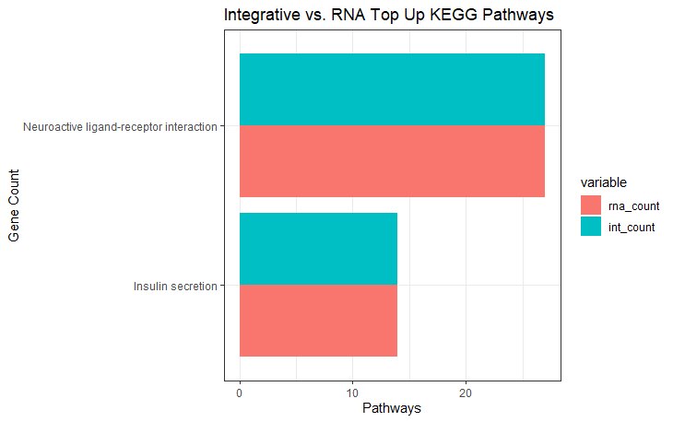
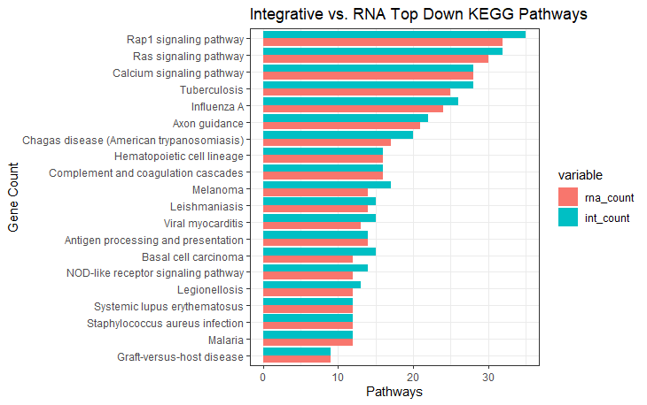
DAVID: Common Paths (KEGG)

Slide 15
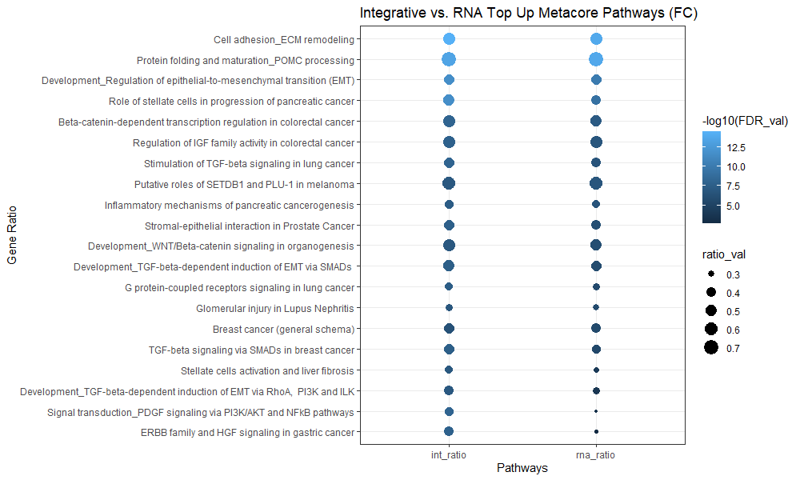
MetaCore: Top Pathways w/ FC

Slide 16
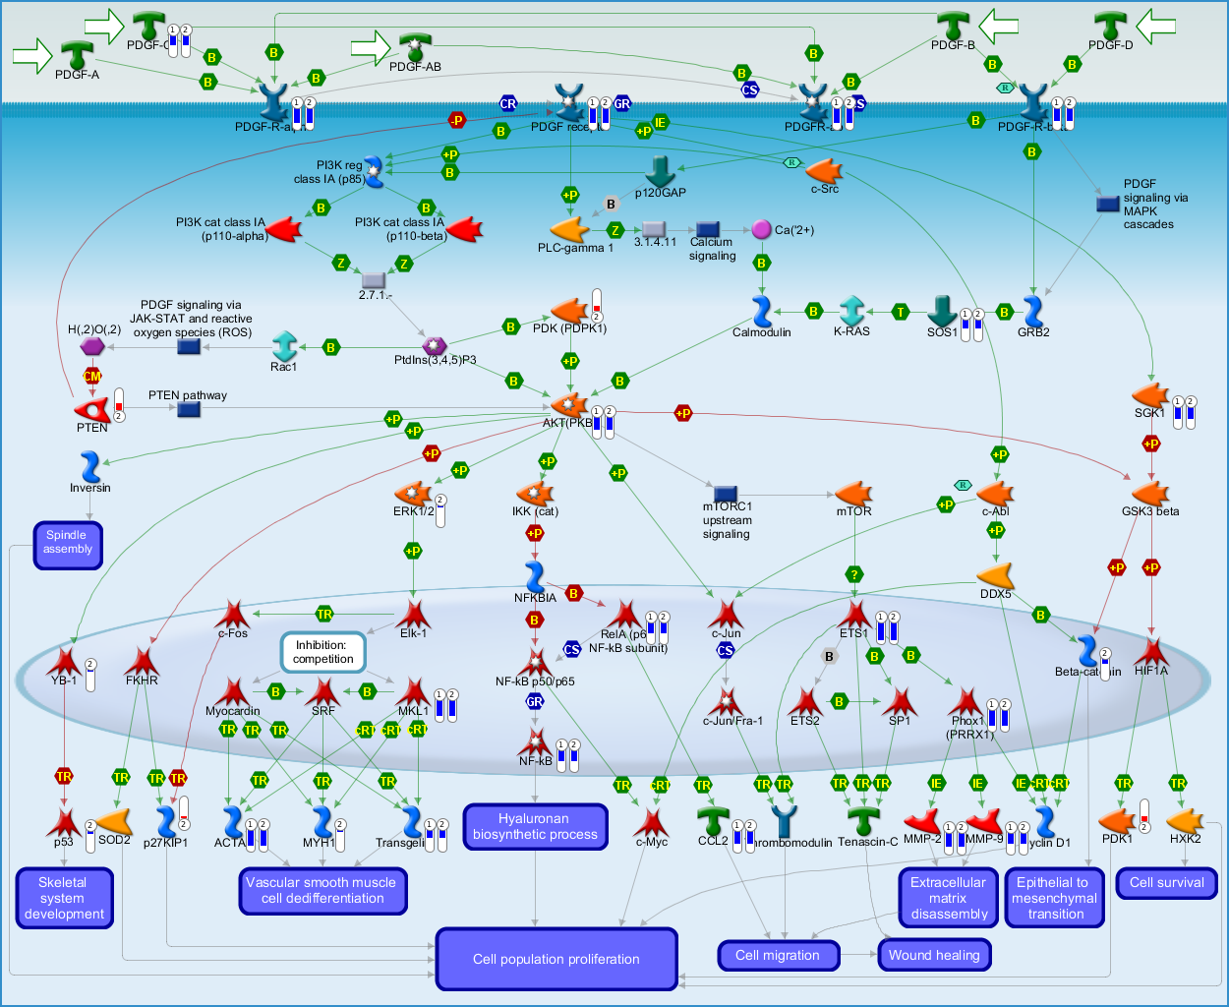
MetaCore: Pathway Visualization
Can look at individual pathways
Show FC from both datasets
Have to look at visualization or network object to see if pathway is upregulated/downregulated

Slide 17
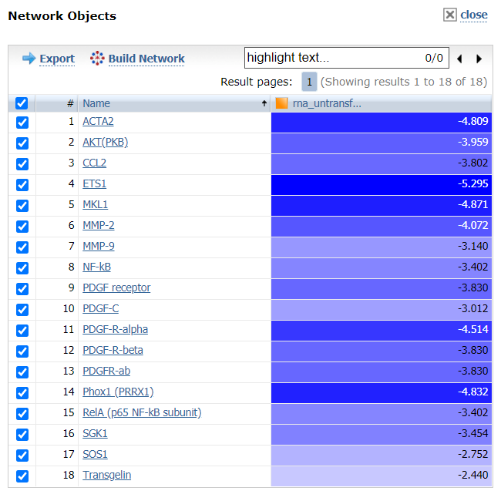
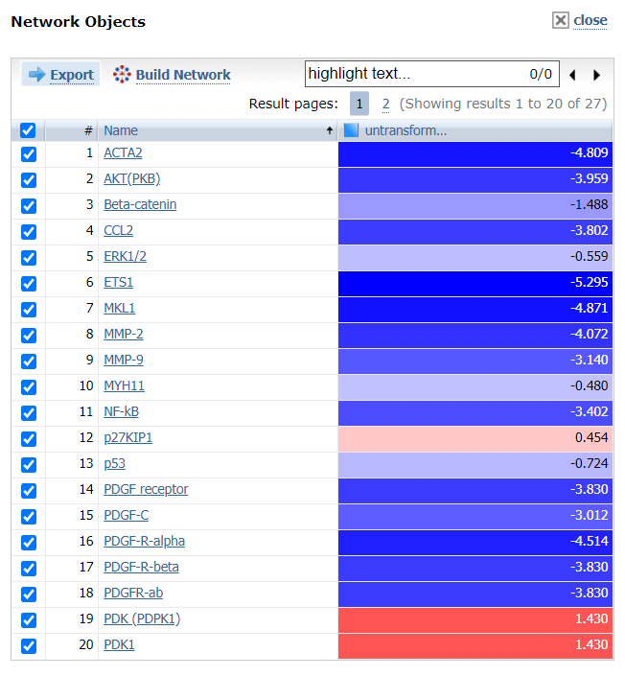
MetaCore: Network Objects
RNA-only
RNA + RPPA

Slide 18
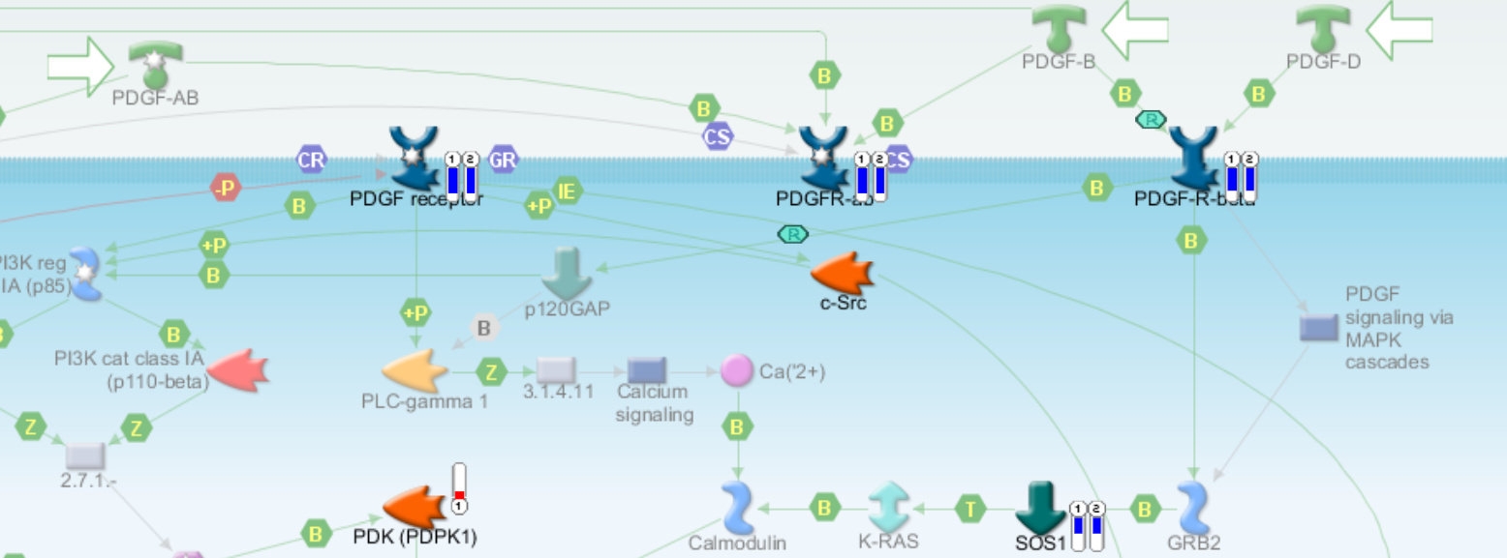
MetaCore: Drug Target Visualization
Semaxanib example

Slide 19
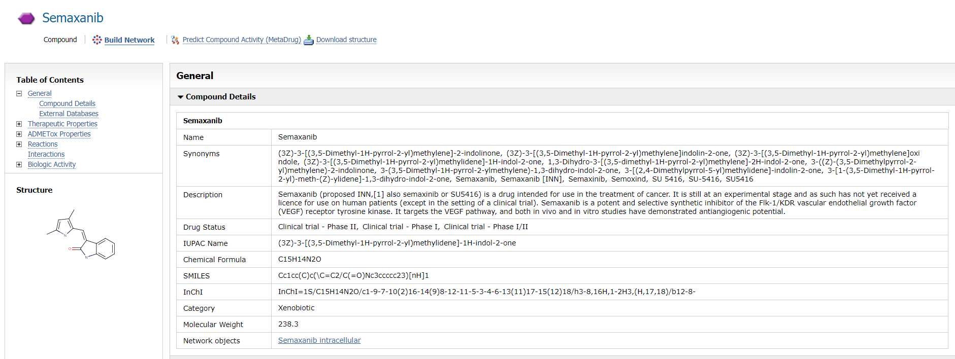
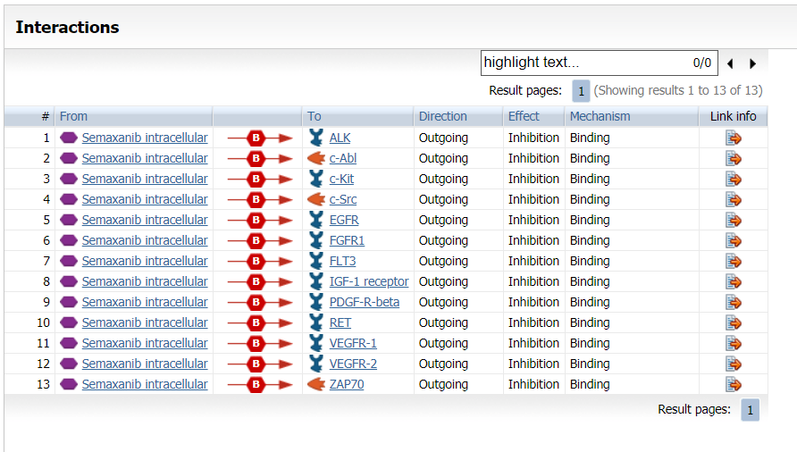
MetaCore: Drug Target Visualization
Semaxanib example
Limited drug analysis without additional license

Slide 20
Supplementary Data

Slide 21
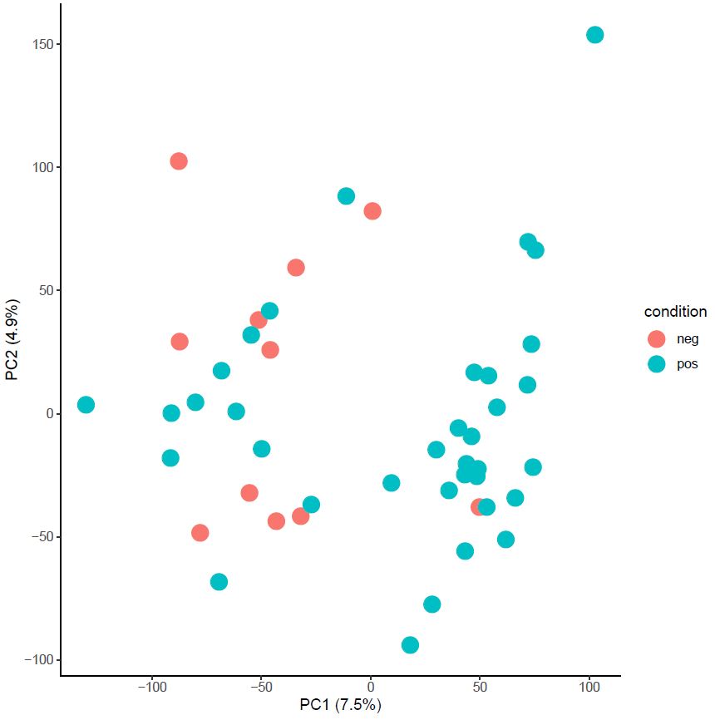
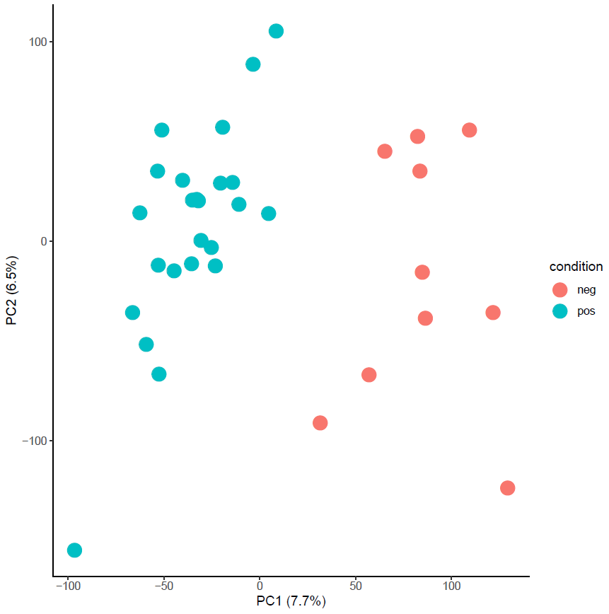
Batch Effect Analysis: RNA-seq
Before
After

Slide 22
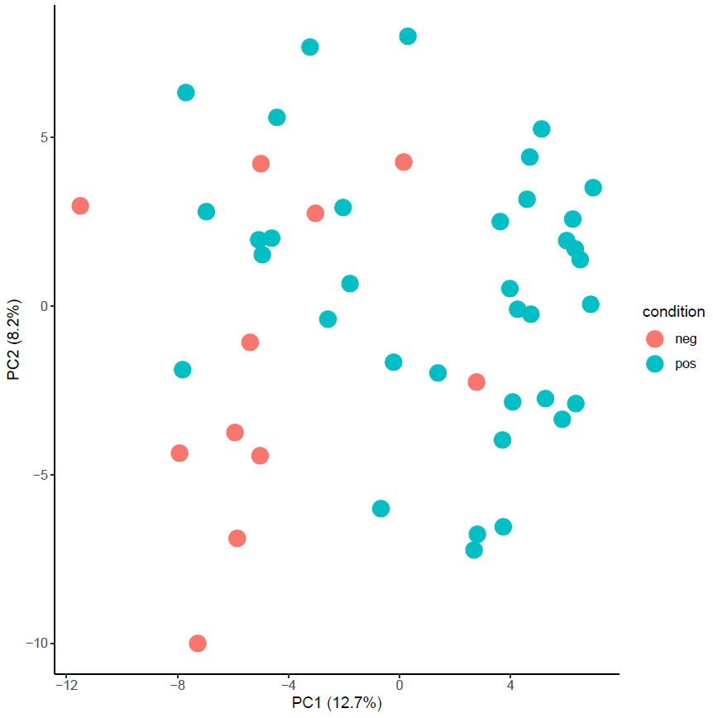
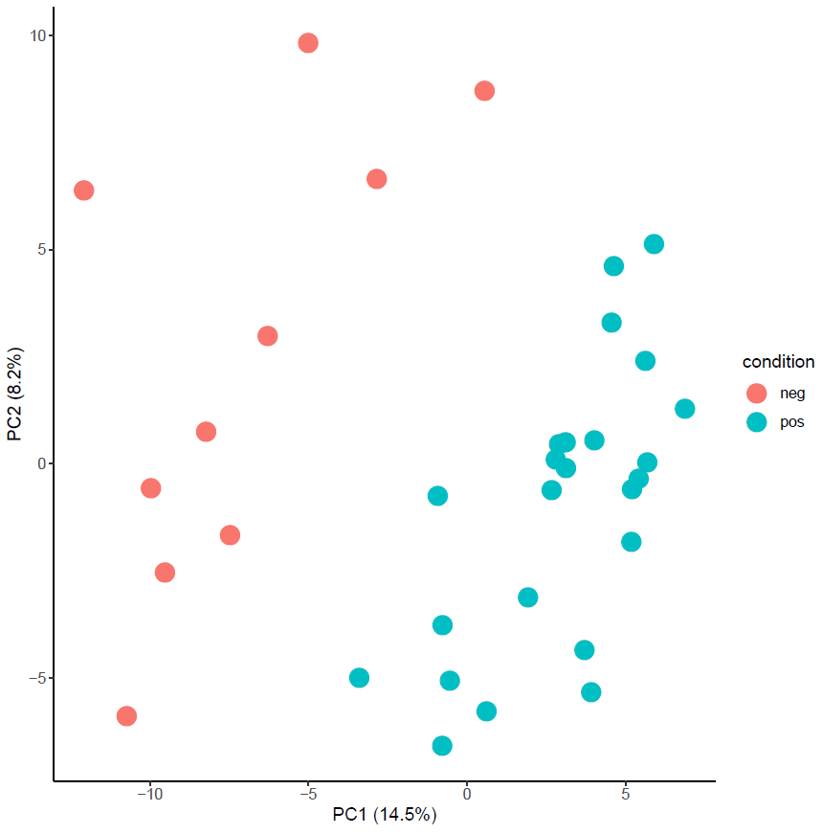
Batch Effect Analysis: RPPA
Before
After

Slide 23
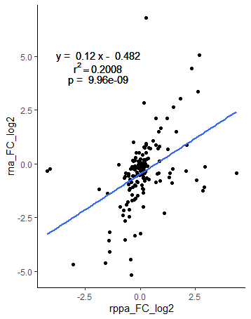
Transformation: Untransformed (w/ phosphorylation)

